Slide 1
Integrating Technology into ELAR
Alissa Carter
Advanced Academic Services/
Instructional Technology Coordinator
alissa.carter@plainviewisd.org

Slide 2
Video Dialogues
"I think students would retain a lot more information if they made a video about the person they're studying or created an instant message dialogue in which they imagine a fictional conversation between characters, as opposed to just taking a test or writing an essay.
"If every class could use some type of blog or Web page, students could post their questions and the teacher would be able to respond for the whole class to see. This means the teacher wouldn't have to answer the same question multiple times, and students would understand homework better. The class could use this blog in other ways, too.
"For example, students could respond to a prompt on the blog for homework, or students could check their answers on the blog to review for a test. This site could also help a lot with students who are absent. In my math class, the teacher created a Web site where students can access all the worksheets. This is a big help to students, because they can complete makeup work more easily, and kids are always losing their worksheets."

Slide 3
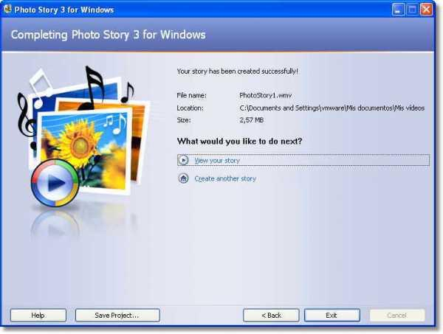
Every Picture Tells a Story
"With Photo Story, you tell a story with pictures. You get pictures for your story, you add voice, and, as an option, you can put in effects or music. It helps me with voice and dialogue in my writing, which you need to keep your listener interested."
Photo Story is a free application within the Windows XP operating system that allows users to create a digital presentation of sounds and images. Fifth-grade students at Denton Avenue School, in New Hyde Park, New York, use the program as part of the language arts curriculum.
In a recent project, students wrote narratives about the teachers at their school. The added layers of images, timing, visual effects, and music help students think critically about narrative and audience.

Slide 5
Global Brainstorming
"Last year, my teacher used Skype in a different way. We read the book The Mysteries of Harris Burdick, by Chris Van Allsburg. We had to come up with a story about each picture in the book, and we worked on the stories with a class in Florida! We were able to work on stories with kids in an entirely different state without even getting on a plane."
Skype is a simple way to conduct phone and video calls free of charge through the Internet. For a free download, visit Skype.com.

Slide 6
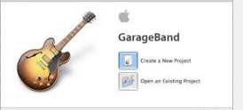
Give Bios a Backbeat
"Students could use Apple GarageBand to come up with a song for English class about their lives, instead of writing in a journal. If I were a teacher, I would first ask the students to write an entry about their life. Then I would ask them to add in words to make the song rhyme. I would also show them how to add beats, change their voice, and remix a favorite song and add it to their song.
"This would give the students freedom, and it would help them work on their grammar skills. I would also advise teachers of other subjects to use this idea. For example, in social studies, we could use GarageBand to come up with a song about a famous historical person and write it as if the person were speaking during a year in which he or she lived. We could then take all the songs and burn them onto a CD so every student had a copy."

Slide 7
Give-and-Take Storytelling
"When I'm writing a story by myself in a Word document, I'm usually at a loss for what to say. I'm always going back and changing things or messing around with fonts. But when my friend and I use the online chat tool Google Talk, we make a story. Line by line, going back and forth, we add on to our crazy plots.
"See, when you chat, you're not alone. Someone is always there to add on. Also, you cannot go back and change things. It keeps the story moving forward, and it's great for rough drafts. I think people could definitely use this in the classroom for creative writing.
"Once you've made your chat, it can be automatically saved and you can easily print it out. When you want to edit the story, all you have to do is copy and paste it into a Word document. It's a way to work together, get out your ideas, and use technology."

Slide 8
Thinking Aloud
"I would use VoiceThread to record responses to poems. Kids think about poems differently than adults. VoiceThread helps kids express their thoughts easily and record their feelings, emotions, and understanding."
VoiceThread is collaborative slide show software that allows users to contribute audio, images, and video. Students in Lisa Parisi and Christine Southard's fifth-grade class at Denton Avenue School use VoiceThread to recite poetry and voice their responses to literature as well as to connect with students around the world. For example, an ongoing project on their class Web site uses VoiceThread to share common phrases in dozens of languages.

Slide 9
Study Homer with a Hedgehog
"If we're studying Homer's Odyssey, I would like the opportunity to learn about it in ways other than just reading. For example, an opportunity to use movies, photographs, or games (such as Sonic Odyssey, which takes Sega's Sonic the Hedgehog character through Homer's Odyssey) would make learning more enjoyable and easier.
Students could relate to the events a lot better and maximize what they get out of it. The option to create a digital presentation (a movie, cartoon, drawing, or online debate) for testing and homework purposes would make it even better."

Slide 10
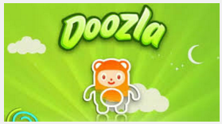
Comic Relief
"For drawing, I use Adobe Photoshop and Adobe Flash. (I am not much of an artist, but they are the ones I like the most.) I recently found Doozla, and my five-year-old cousin loves to draw with it. For cartoons and comics, I use an application called Comic Life."

Slide 11
7 Amazing Websites to Help English Teachers
New York Times Learning - The New York Times has a treasure trove of resources for teachers. My favorites are the text to text options that connect current events with other non fiction articles or famous pieces of literature like A Raisin in the Sun.
Web English Teacher- This was my go-to website when I was first starting out. The site is divided up by topic, author, text etc and provides links to all sorts of resources. Most, if not all, are free.
Scholastic Book Wizard- I love this tool so I can make sure I'm giving students books that are appropriate for them. You can search many books here and get an interest level and a reading level identification. It also tells you if there is an AR or SSR quiz associated with the book.
Facing History & Ourselves- If you need primary sources this site is rife with them. This is a great way to find background information for historical context when reading novels.
Free Rice- This website lets students have fun while learning. They can choose to work on grammar or vocabulary. It is adaptive and it ends up donating to charities around the world that feed the hungry.
Poetry Foundation- I love this website for finding poems that demonstrate different types of figurative language or that deal with specific topics. Some even have recordings with them.
NewsELA- If you need good non-fiction current events for your classes this site has articles that are written at 5 different reading levels. It's great for differentiation!

Slide 12
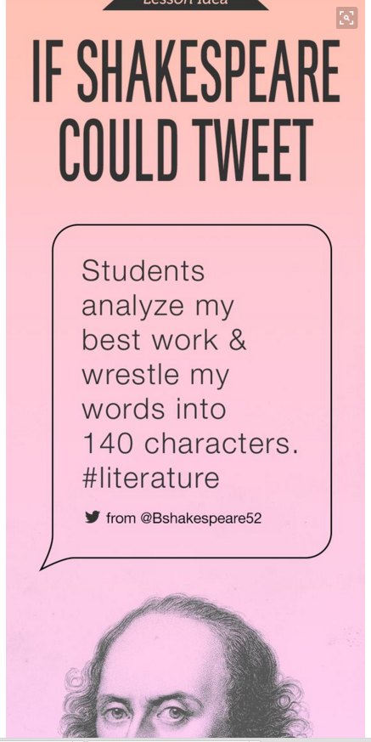

Slide 13
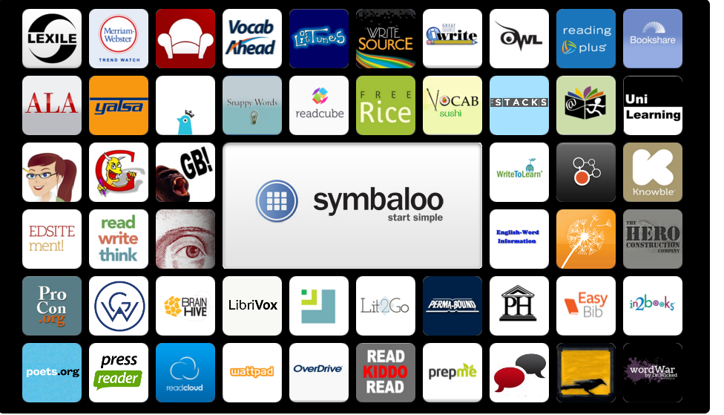
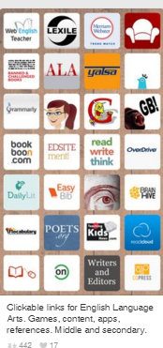

Slide 14
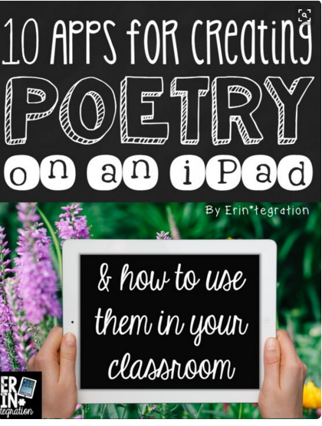
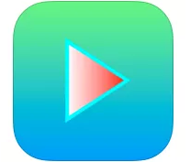
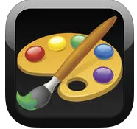
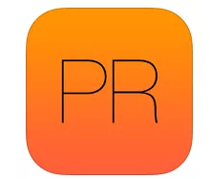
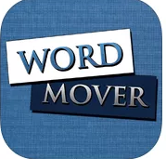
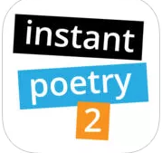
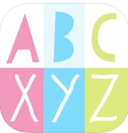
Poetry http://www.erintegration.com/2015/04/08/10-apps-for-creating-poetry-on-the-ipad/
USE POETREAT TO WRITE HAIKU AND RHYMING POEMS.
SET UP A POETRY RECORDING AND LISTENING STATION WITH KIDS RECORDER
USE DRAW FREE ON THE IPAD (OR DOODLE BUDDY) TO CREATE PAPERLESS BLACKOUT POEMS.
MAKE ONE-LINE CONCRETE POEMS ON BEND PIC EDITOR.
CREATE ACROSTIC POEMS ON PIC COLLAGE
FIND RHYMING WORDS WITH PRIME RHYME – A FREE RHYMING DICTIONARY APP.
LINK PICTURES TO POETRY WITH THE VISUAL POET APP.
MIMIC MAGNETIC POETRY OR FOUND POETRY WITH WORD MOVER.
HOOK RELUCTANT POETS WITH INSTANT POETRY
ARRANGE POEMS INTO BEAUTIFUL SHAPES AND COLLAGES WITH VISUAL POETRY.

Slide 15
Top Free Reading Apps http://rachelktutoring.com/blog/top-free-reading-apps/
Sight Words - This app is great practice for reading sight words. The student listens to the word being read, and then has to touch the word that matches from the choices given. Word lists are provided, but you can also add your own words and even record your voice reading them!
ABCmouse.com – These are fun stories that are read out loud with high quality narration and music. These are great for beginning readers!
VTech: What’s That Noise – Here is a storybook app about Rufus the dog moving to a new city. This fun app is engaging with colorful animations on each page. It also has reading questions too!
Grammar Wonderland (Elementary) - Practice using nouns, adjectives, verbs, and more in this fun app! These colorful and interactive games will definitely keep kids entertained. Also, check out Grammar Wonderland (Primary) for the same kinds of fun games for younger learners.
Aesop for Children – This app provides over 140 classic fables accompanied by illustrations and interactive animations. There is no read-aloud option, so for young readers an adult would need to narrate. The animations are really simple, but it’s still a great way to read fables!
Phonics Genius – This app is loaded with over 6,000 professionally recorded words that are grouped into 225 phonics categories. It is designed to help students recognize and distinguish words by sounds. Great practice!
Grammar Jammers Primary Edition – This one is so fun! There are catchy animated songs and rhymes to make learning about nouns, verbs, sentences, etc. way more entertaining. Students then can practice their skills after hearing the songs. (There are also elementary andmiddle editions available, but those aren’t free.)
Sparklefish – If you like Mad Libs, you will love this app! You can record words in your own voice for playback in funny ad-lib stories. Endless fun!
Disney Storytime – This app comes with 3 free Disney stories! (The rest of the stories you have to buy.) Students can read by themselves or have the option of narration. Many kids love Disney, so these are great for any reluctant readers.
StoryChimes – Enjoy the classic tales of the Three Little Pigs and The Ugly Duckling with beautiful illustrations, sound, and music. Just note that there are ads in these apps. To get them ad free you have to purchase them. Other free stories: Snow White Sleeping BeautyThumbelina

